Slide 1
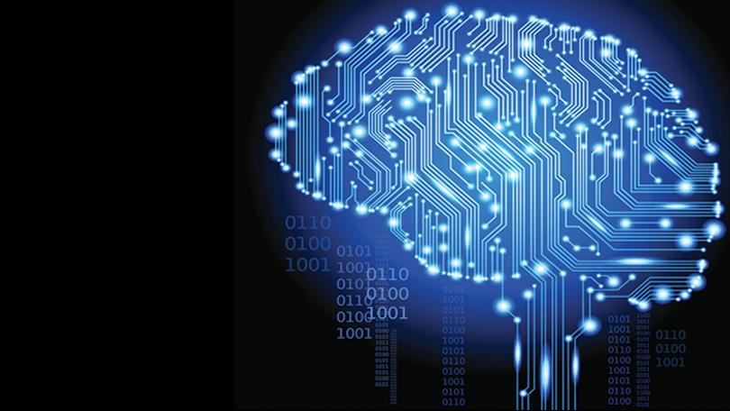
RNN part 2
deep learning
reading group
July 26

Slide 2
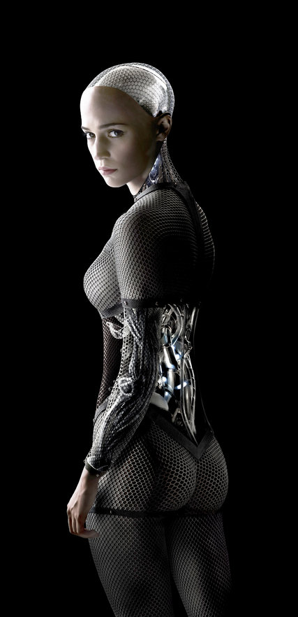
Outline
TSA Challenge
Long-Term Dependencies
Bidirectional RNN
Encoder-Decoder
Deepness in RNNs
Recursive NN
Echo State Networks
Multiple Time Scales
Laughing Silently To Myself

Slide 3
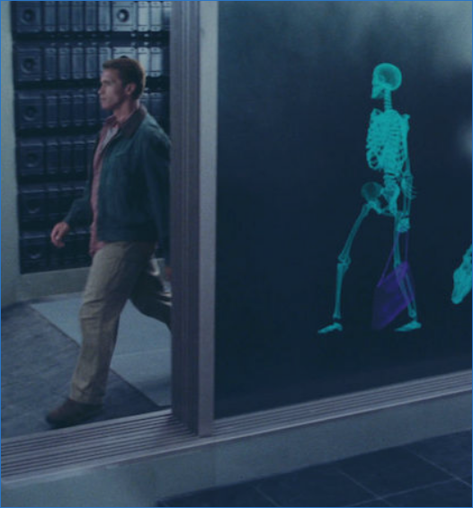
TSA: Your mission, should you choose to accept it...
Identify “targets” from “naked body scanner” images.
Challenge hosted on Kaggle.
December 4 submission deadline
raw data is ~50G
→ but N is only 1147!
(with only ~15% positive)
https://www.kaggle.com/c/passenger-screening-algorithm-challenge/data

Slide 4
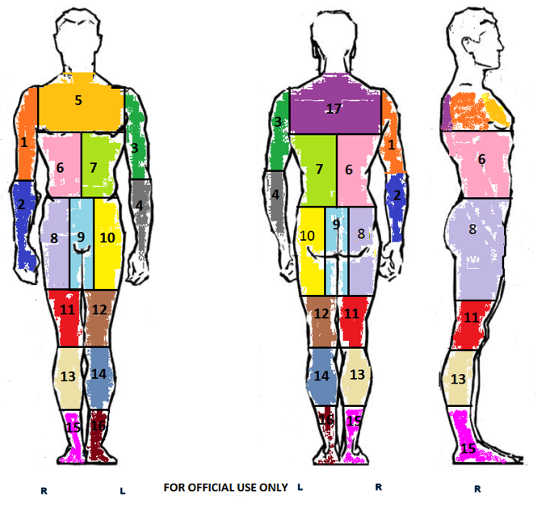
Goal is to identify threats in each of 17 body zones.
N = 1147 labelled data points
datapoints are in multiple formats:
3D
series of 2D images from different angles, and
"raw" format
the 2d series (.aps files) for each datapoint is 16 images of the person rotated about z axis

Slide 5
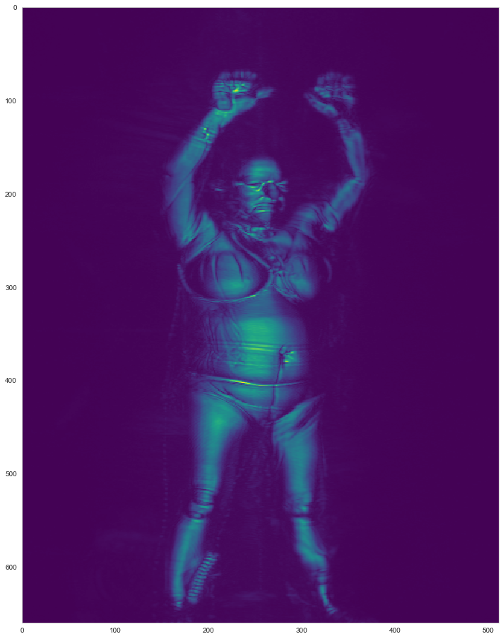
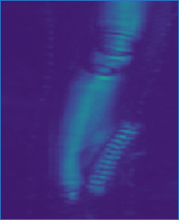
Example Data: threats in zones [7,14,15] -(L torso, L calf, R foot)

Slide 6
Winning & competing
Two stage competition:
stage 1: you must submit model
stage 2: submitted model run on unseen dataset
no “scientific” code changes
hyper parameters must be fixed
only automated parameter tuning allowed
Use of external data is permitted, provided the data is freely available.
Submissions are scored on log loss.
$1,500,000 in total prize money
top ten positions receive $
publication?

Slide 7
RNN weakness - Long-Term Dependencies
chain rule is re-applied every time step
this creates an exponential decay (or explosion)
this problem & its effects has many names:
vanishing & exploding gradients
exponential IIR decay
BIBO filter stability
problem:
late time outputs are minimally affected by early time inputs, but
late time outputs get maximum effect from late time inputs
IDEA: if we feed data into the RNN backwards, the reverse would be true, i.e:
late time outputs are maximally affected by early time inputs, but
late time outputs get minimal effect from late time inputs

Slide 8
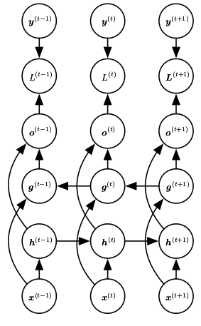

Bidirectional RNN
one half of layer receives inputs forwards, a second half receives inputs backwards
now, output is affected maximally by both the early and late inputs
But what about effect from inputs in the middle?
→ skip connections!
SUMMARY: in practice, bidirectional RNNs have been very successful

Slide 9
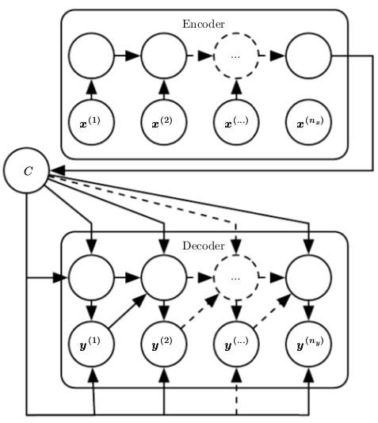
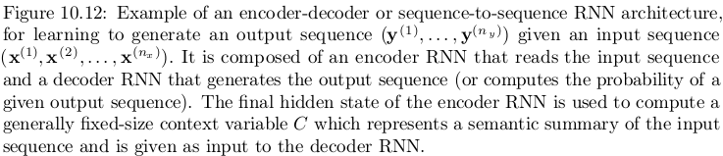
Encoder-Decoder
Sequence to Sequence
Architectures
idea to to map a sequence to a fixed length vector (Context) and then back
lengths may vary from eachother

Slide 10
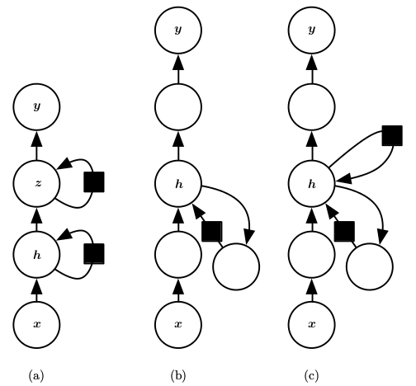
Deepness in RNNs
deeper is usually better
more complexity
harder to train
more local minima?

Slide 11
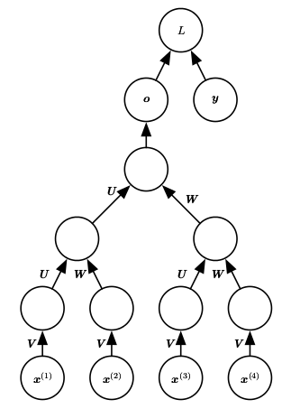
Recursive NN
a generalization of RNNs:
tree rather than a chain
have been successful in:
processing data structures as input to NN
natural language processing
vision
advantage: for processing the same amount of data, the maximum depth is much smaller
you control the tradeoff between the difficulty of depth and long term dependencies

Slide 12
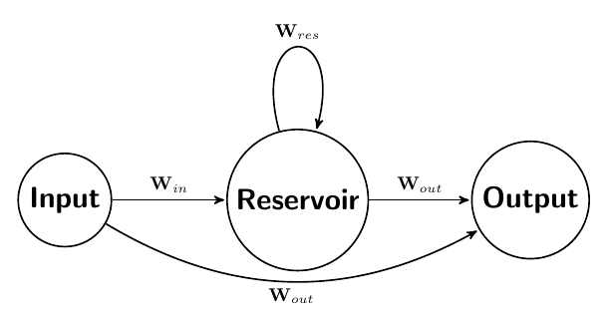
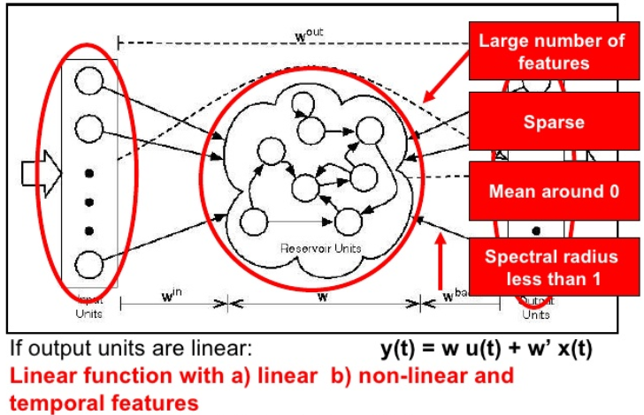
Echo State Networks
a sparsely connected hidden layer (~1%) with a training algorithm focussing on:
set the recurrent weights such that the recurrent hidden units do a good job of capturing the history of past inputs, and learn only the output weights
reservoir computing: hidden units form of reservoir of temporal features which may capture different
aspects of the history of inputs

Slide 13
Multiple Time Scales
leaky units - hidden units with linear self connections such that the product of derivatives is close to 1
removing connections

Slide 14
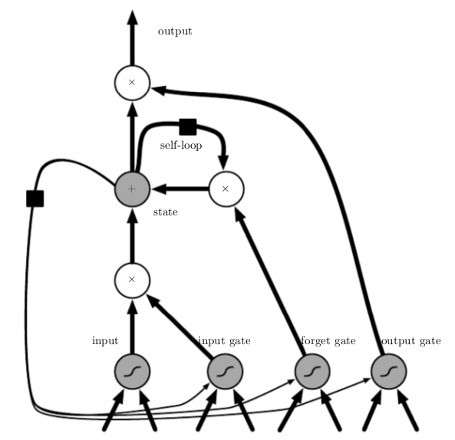
Gated RNNs - LSTM
input gate
output gate
forget gate
self loop

Slide 15
LSTM
input gate:
output gate:
forget gate:

